Slide 1
Average velocity profiles of the movements

Slide 2
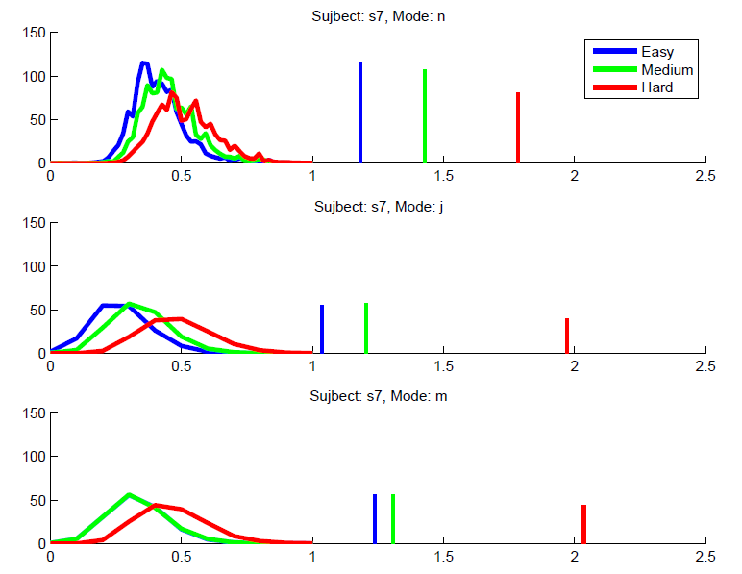

Slide 3
Normal Judder Masking

Slide 4
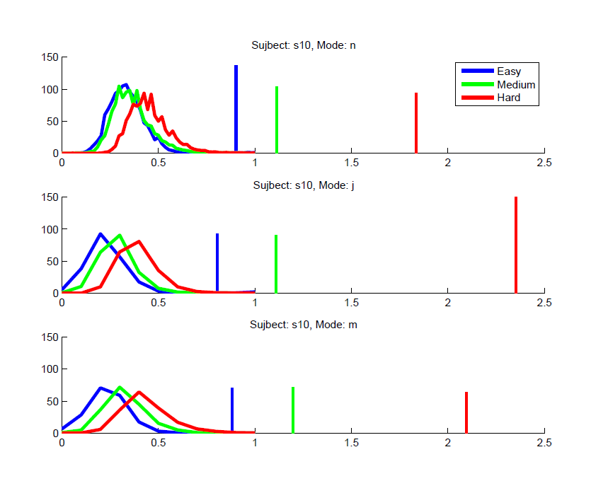

Slide 5
Normal Judder Masking

Slide 6
Cumulatively – 6 subjects

Slide 7
Average the movements and look at the ballistic movement & the correction portion independently.

Slide 10
Determine the ideal path: initial point of the trial to the target. Plot the deviation from the ideal path. Compare the conditions.

Slide 11
It looks nasty so don’t get scared off

Slide 14
Plotting the averages of the previous plot. Just looking at deviations from the “optimal direction”

Slide 17
Navigation task: 1 sec after collision. Looking at the correction techniques

Slide 20
Heatmap of the collisions. Subjects combined. Difficulties combined.

